Slide 1
Route Handler-API Development
Subramanian Murugan

Slide 2
Session Agenda
API Development
Add your second bullet point here
Add your third bullet point here

Slide 3
Route Handlers

Slide 4
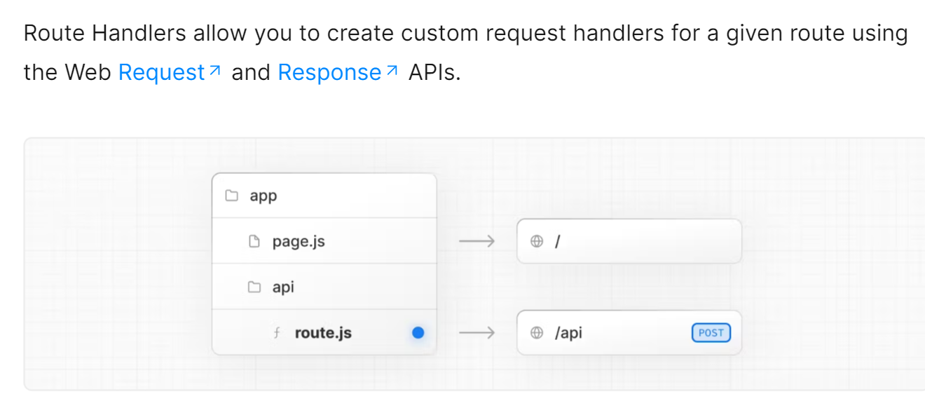

Slide 5
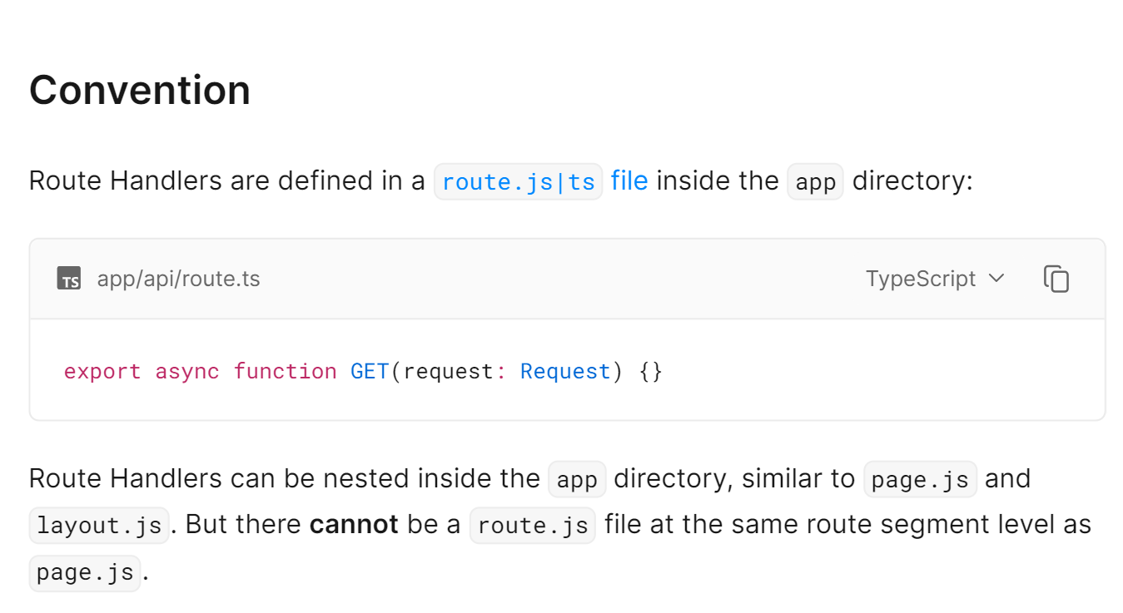

Slide 6
Add a Slide Title - 3

Slide 8
Add a Slide Title - 4

Slide 9

Picture with Caption Layout
Caption

